Slide 1
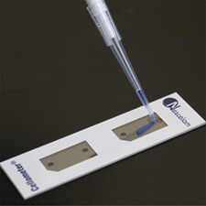
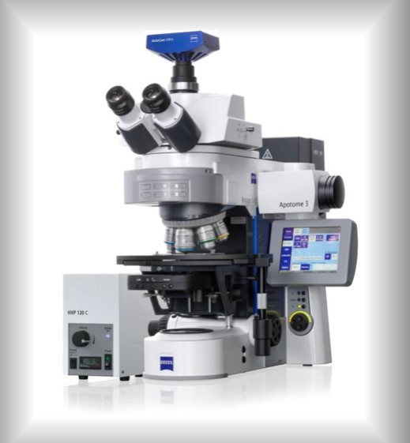
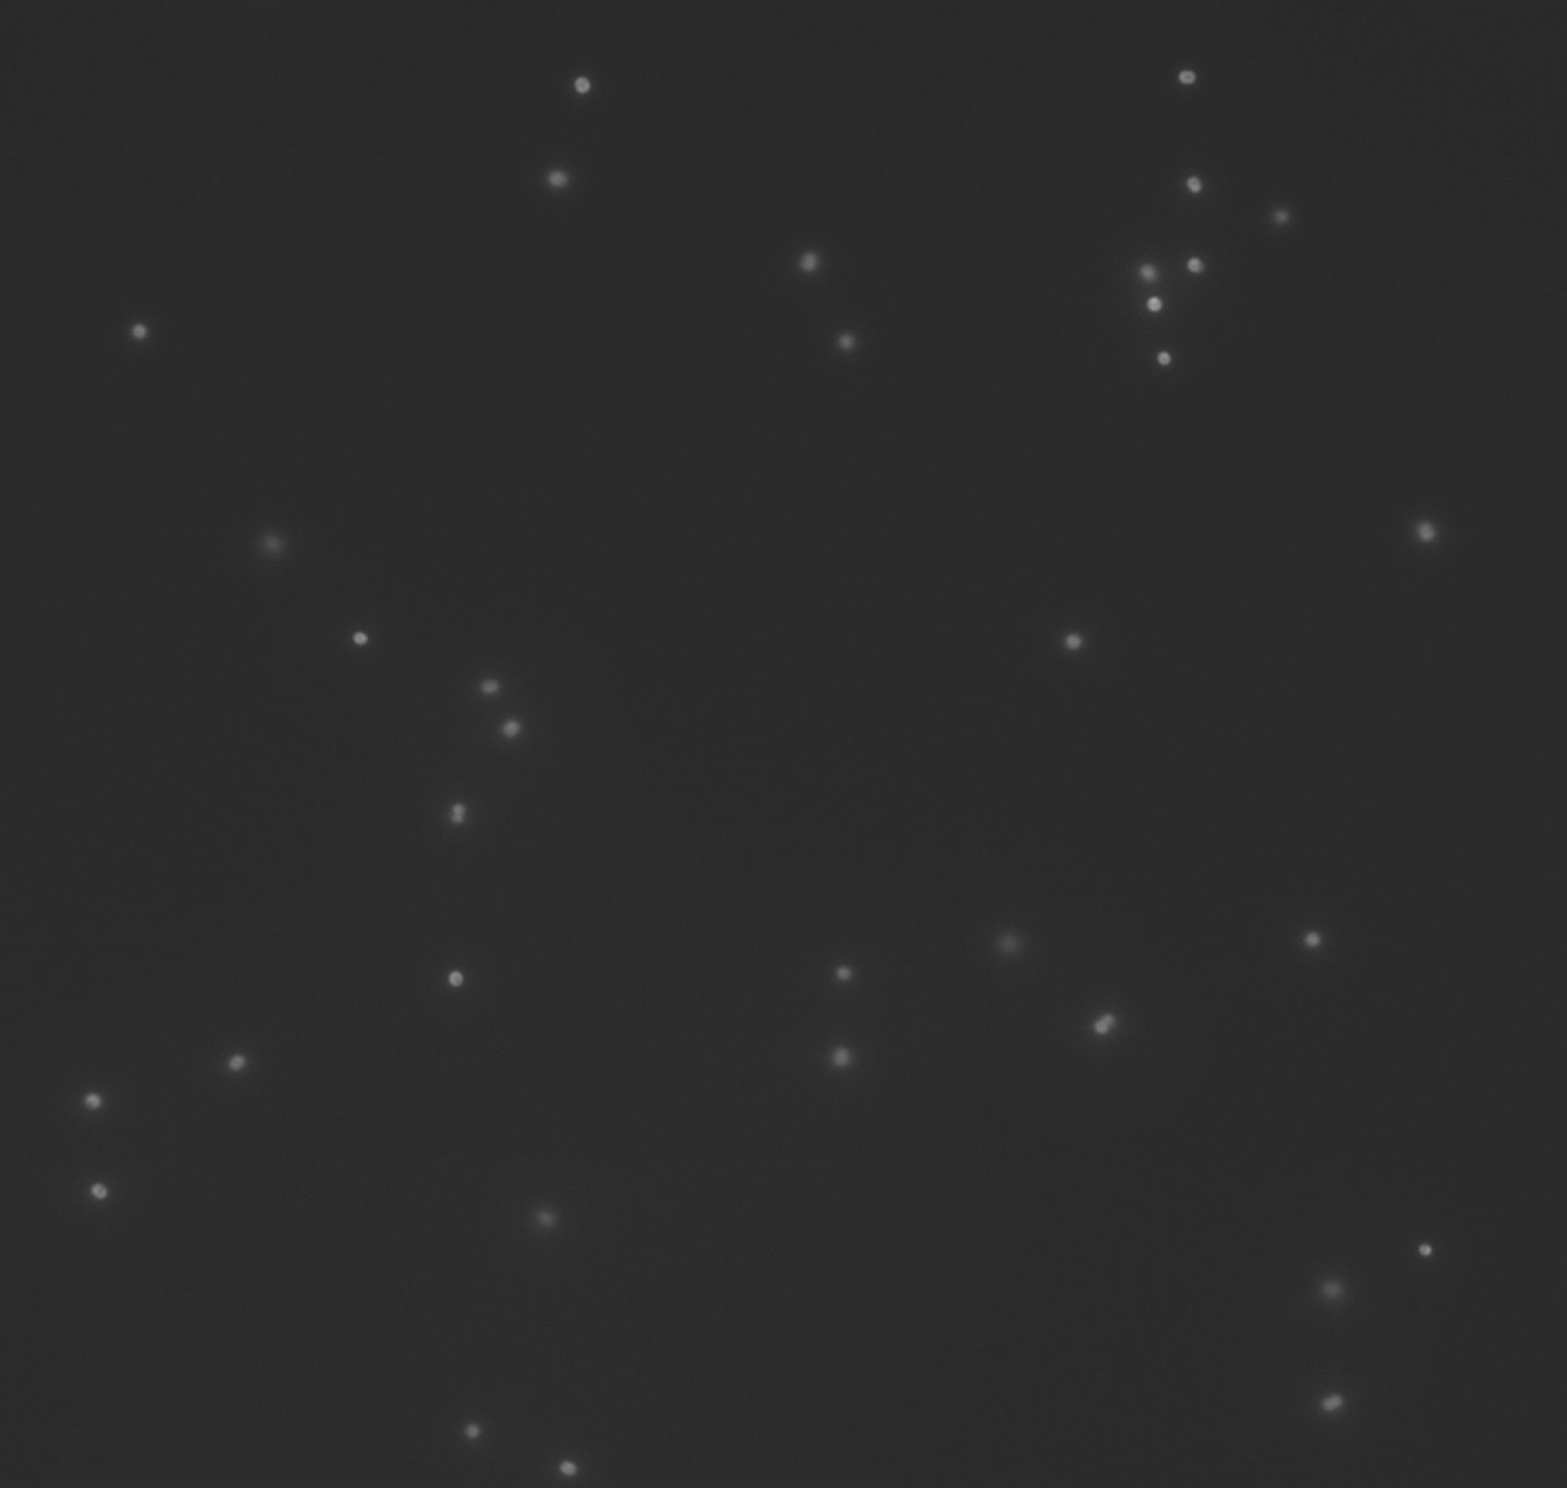
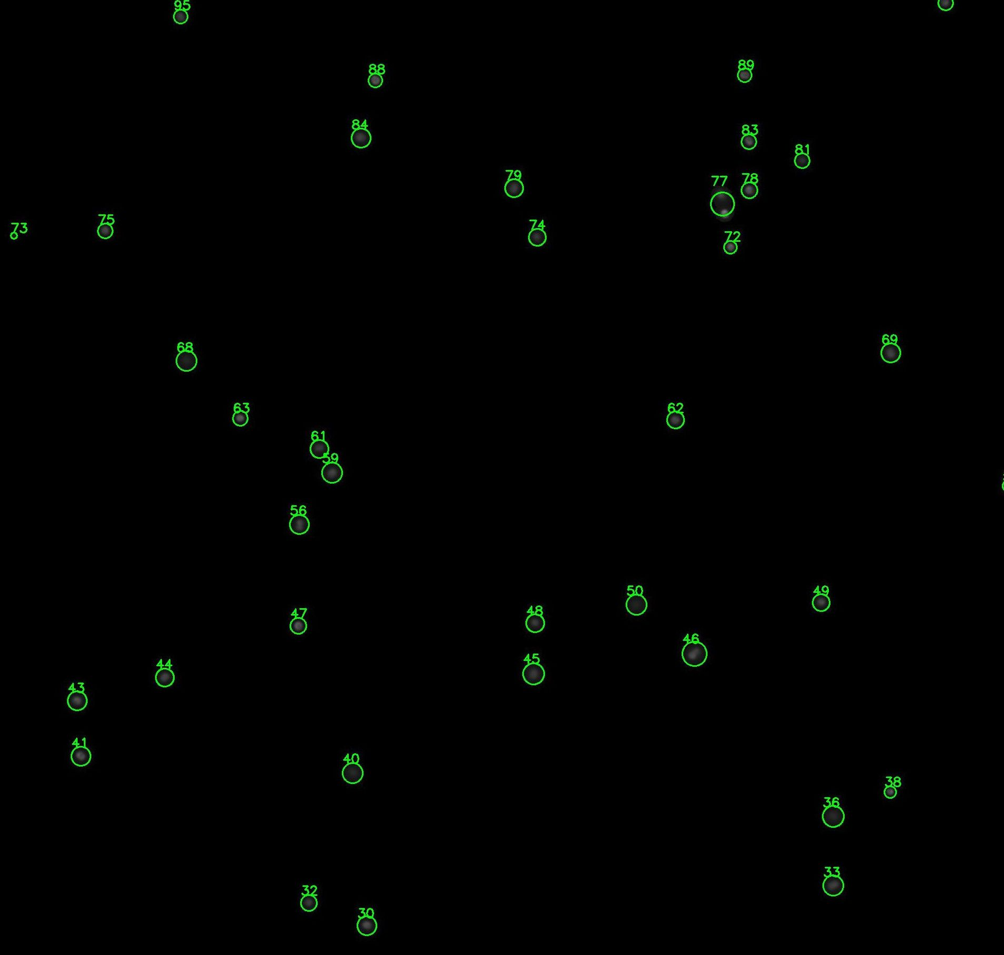
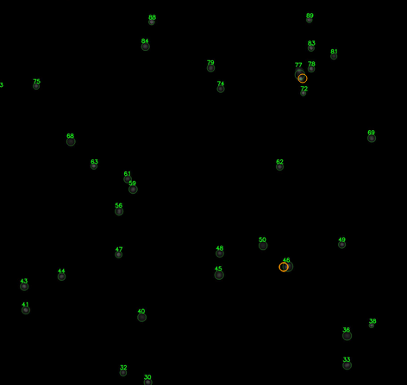
Pipette the cell suspension sample to the counting chamber
Perform fluorescence microscopy imaging
Analyze the images by this tool (see the instruction below)
Review the results and verify if all cells were identified properly
In case some cells were missed, perform manual correction

Slide 2
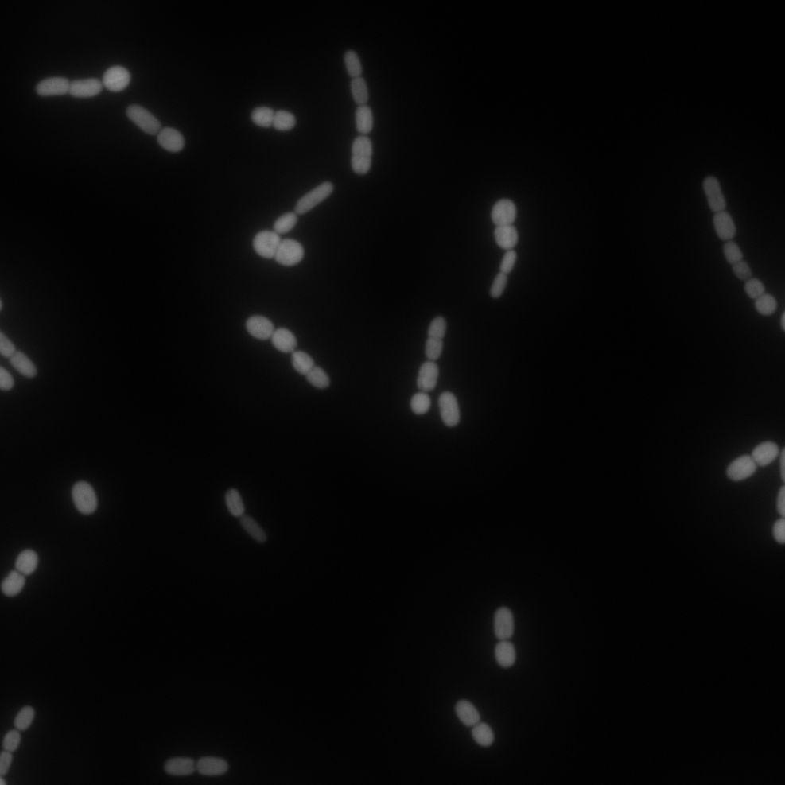
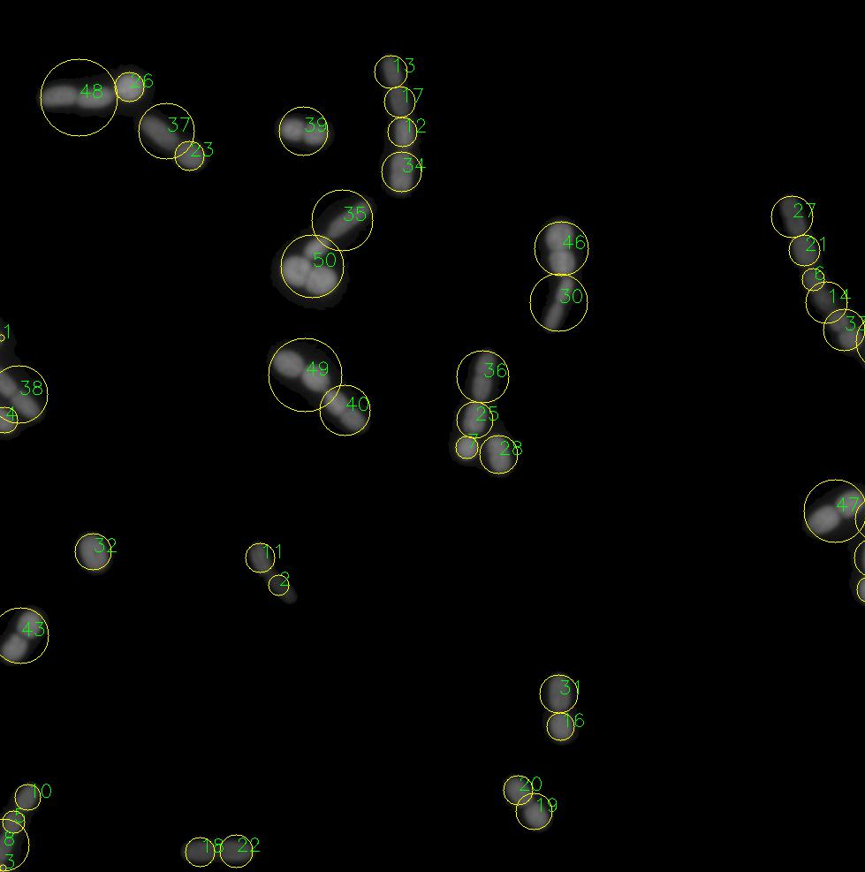
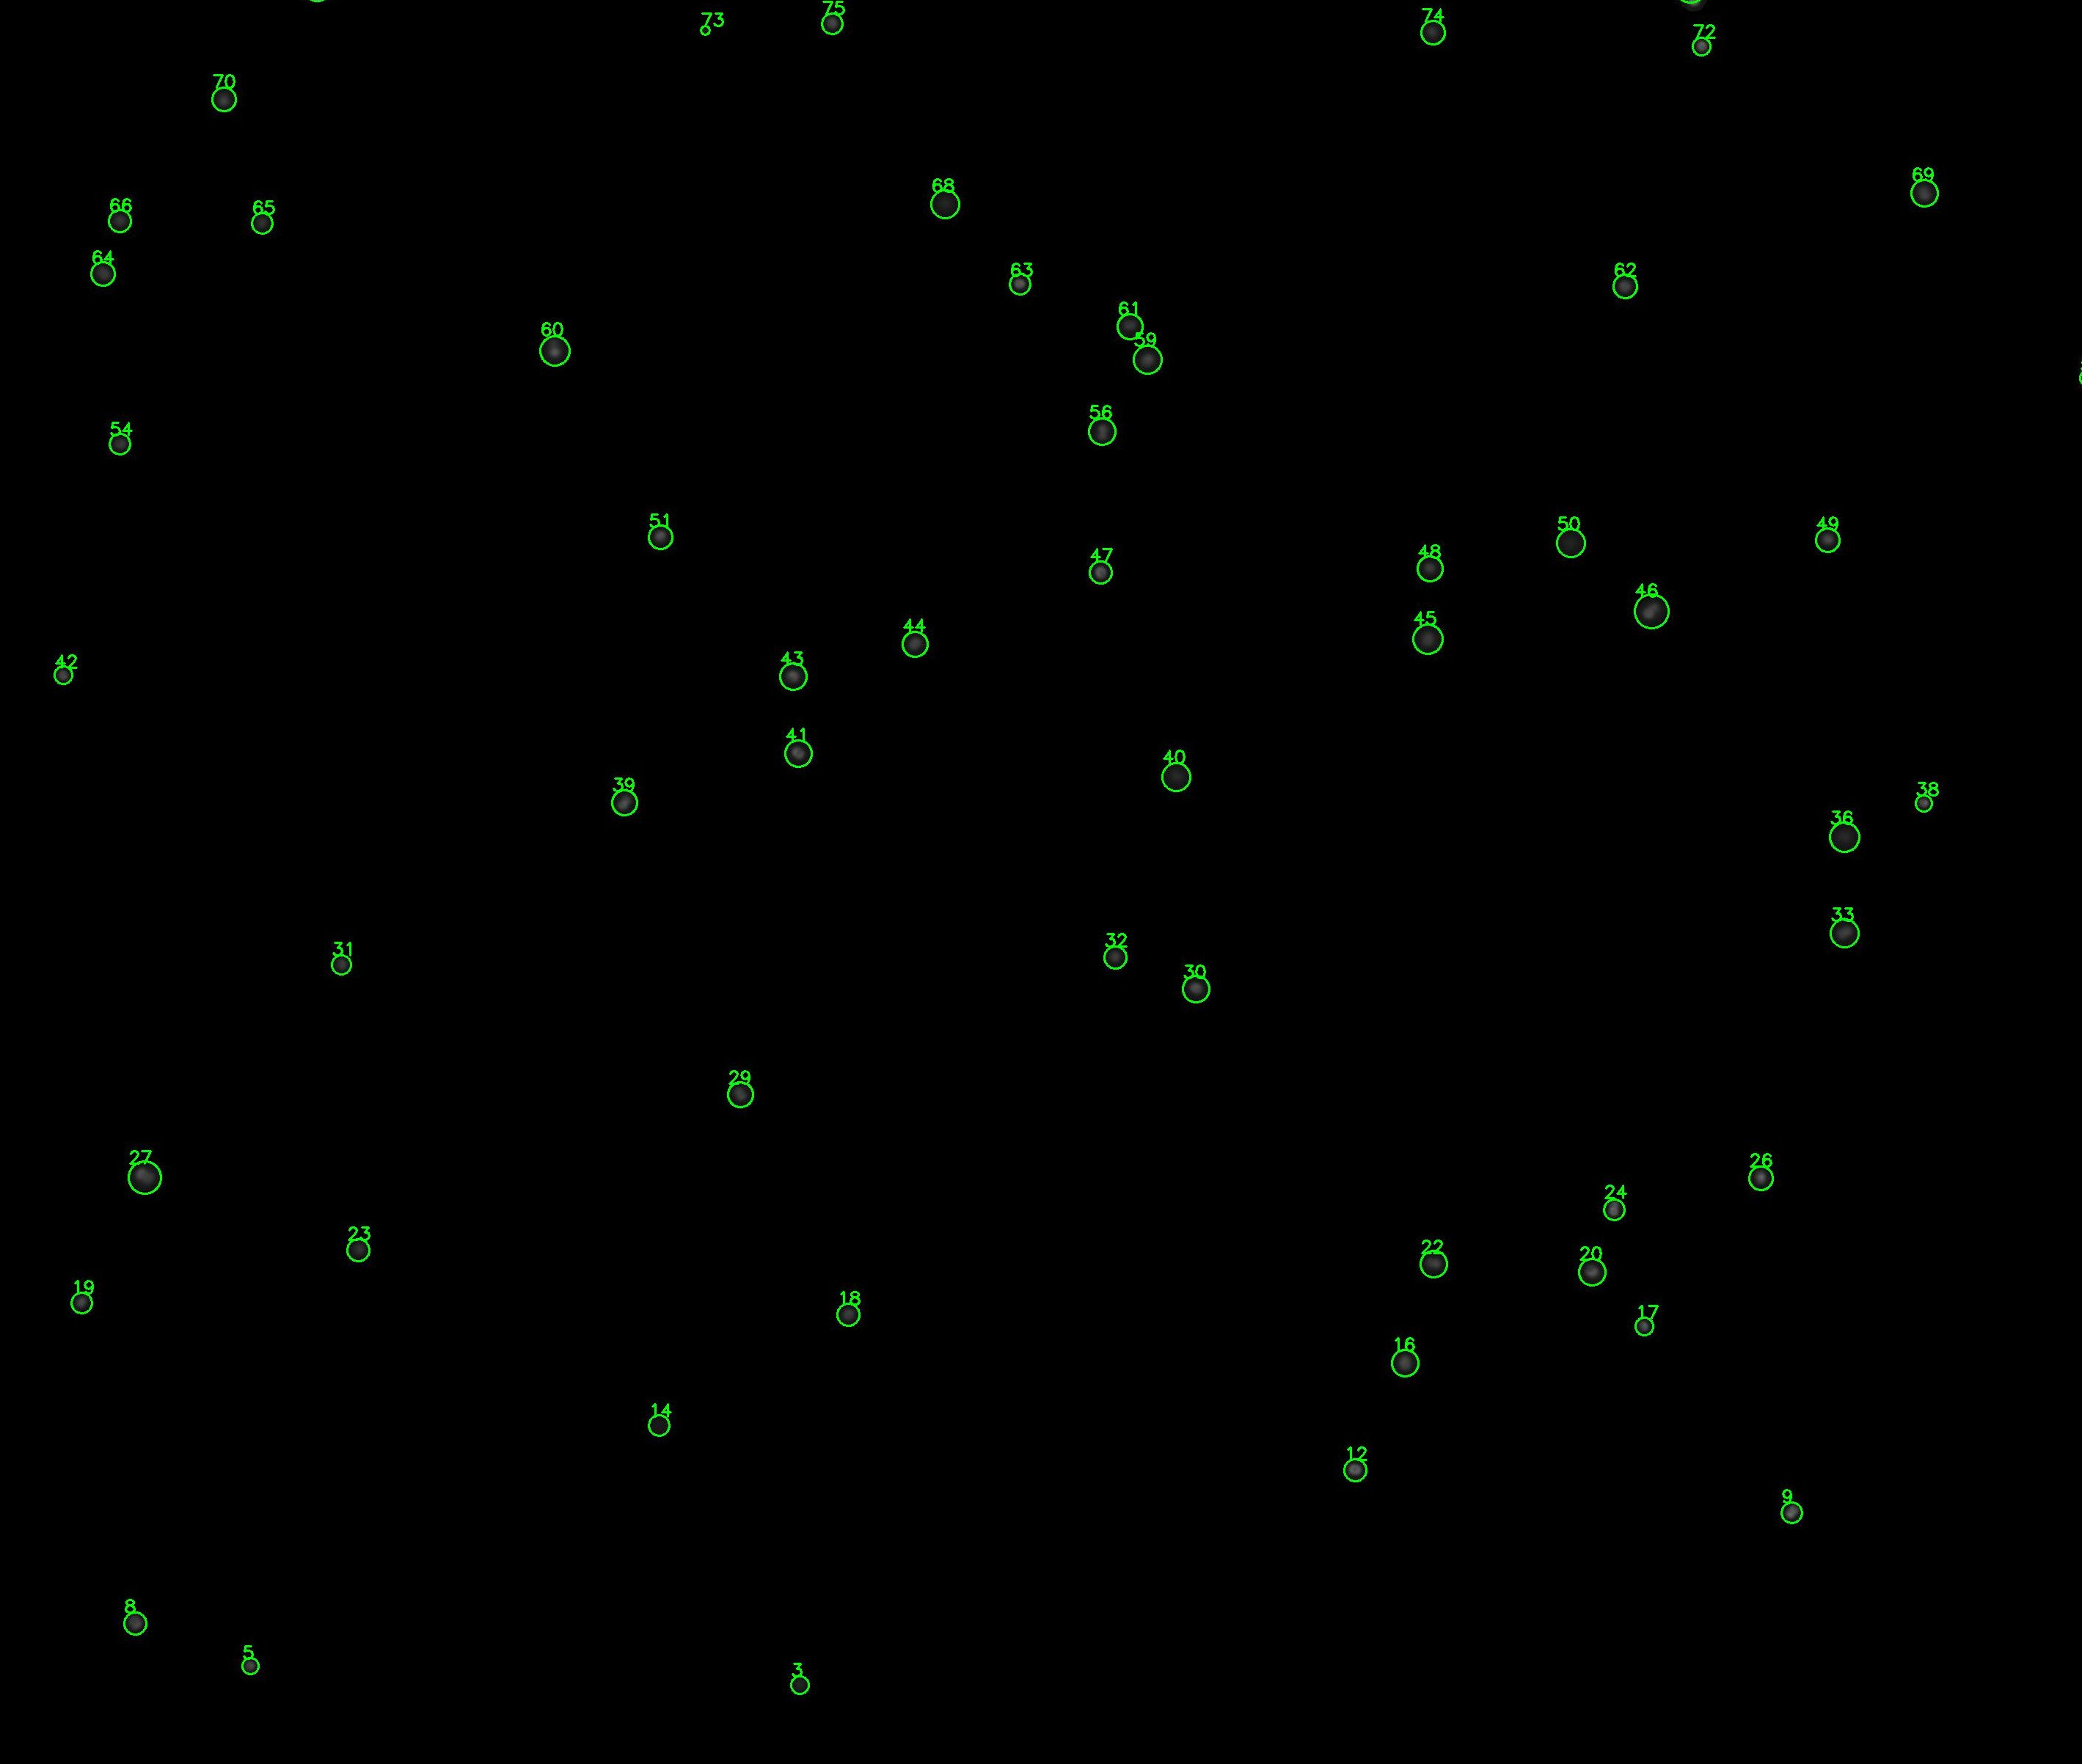
Pipette the cell suspension sample to the counting chamber
Perform fluorescence microscopy imaging
Analyze the images by this tool (see the instruction below)
Review the results and verify if all filaments were split properly and all individual cells were identified
In case some cells were missed, perform manual correction

Slide 3
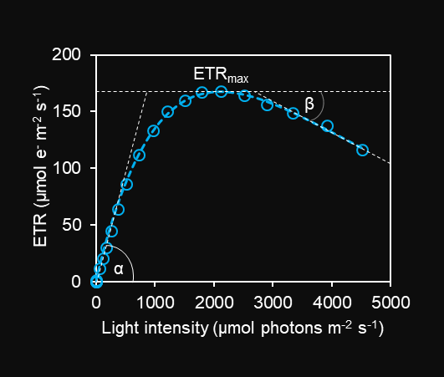
Rapid light curve example

Slide 4
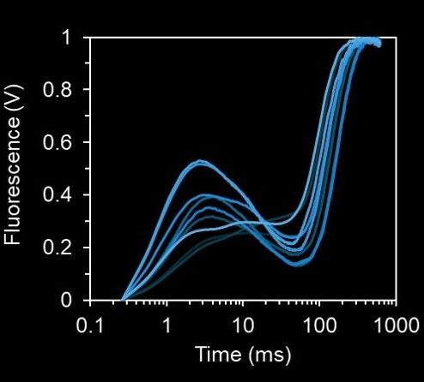
P
I
J
O

Slide 5
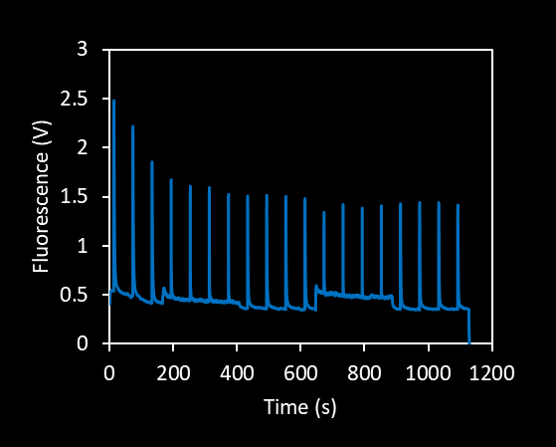
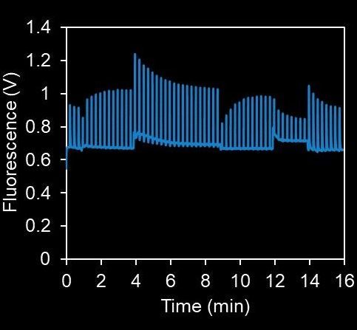

Slide 6
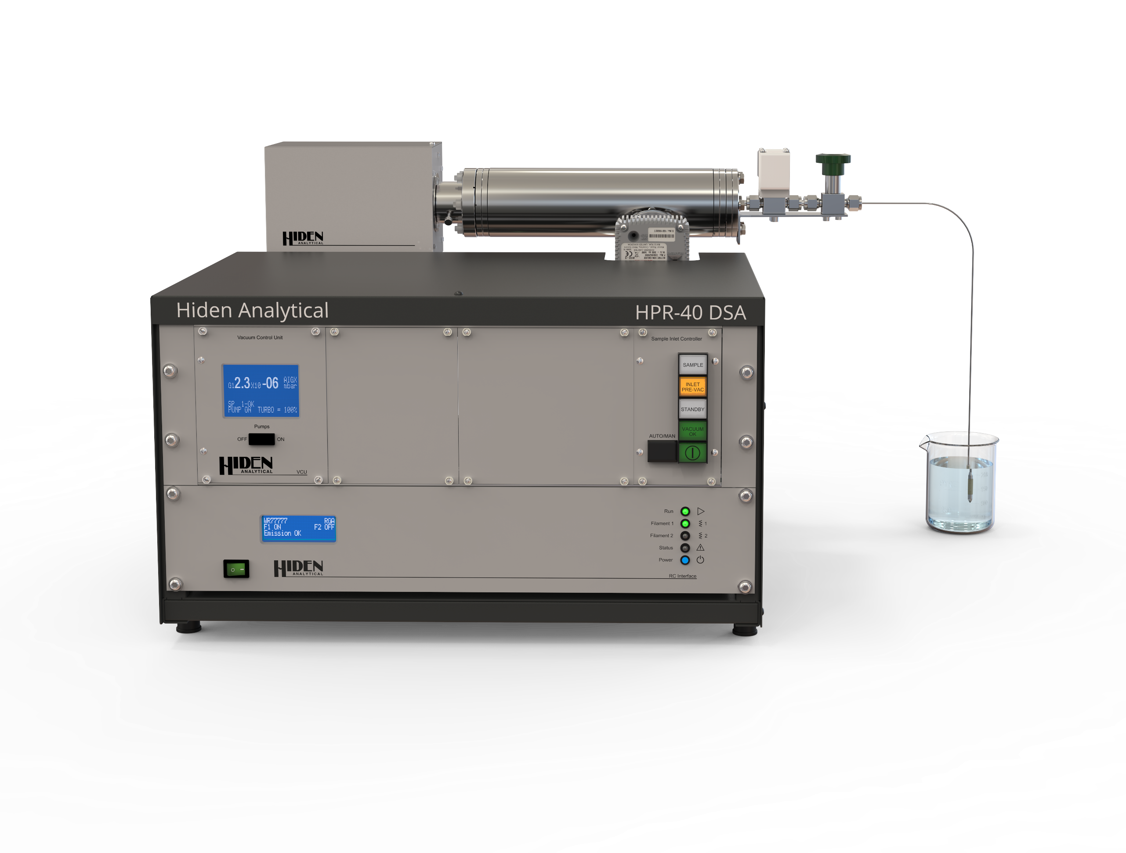
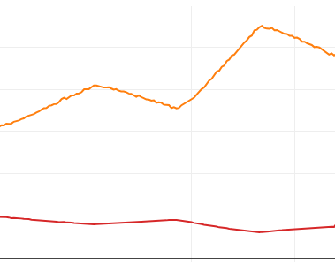
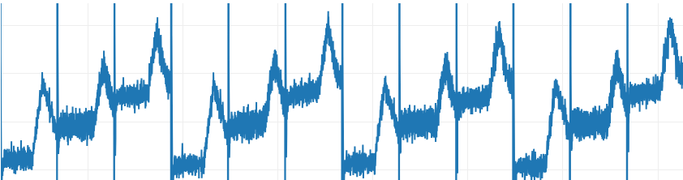
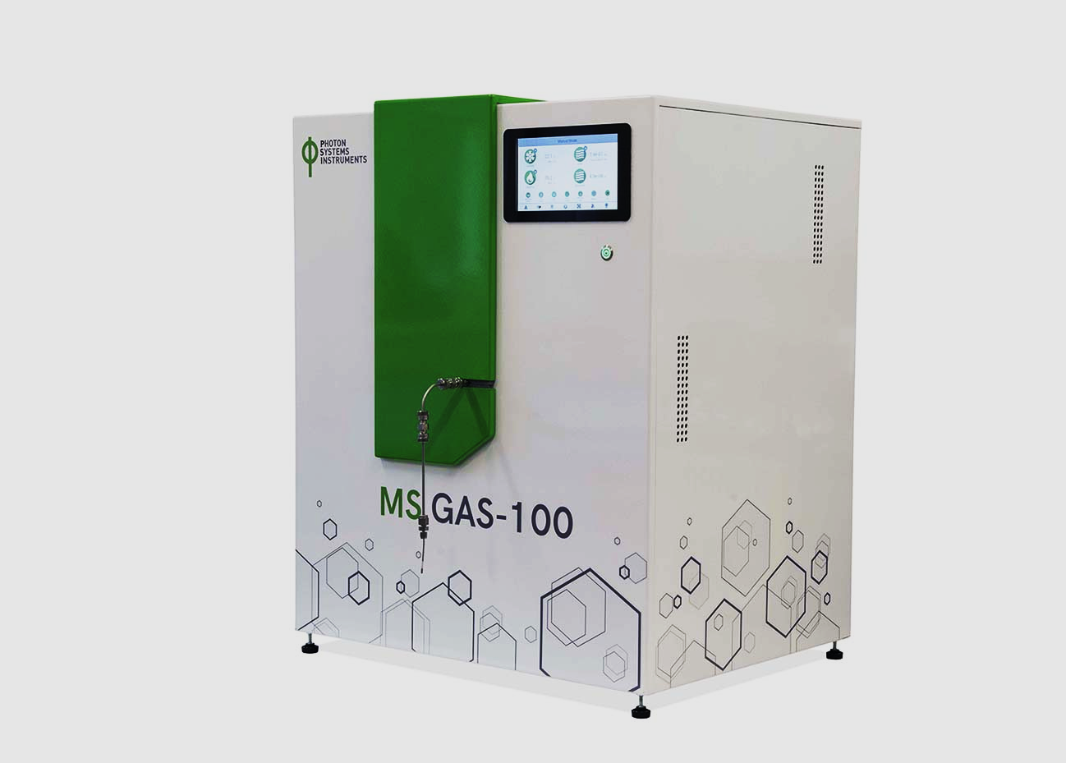
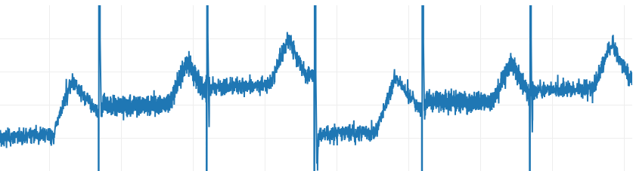
MIMS signals (a.u.)
dO₂
dCO₂
Time (min)
MIMS signals (a.u.)
dO₂
Time (min)
MIMS signals (a.u.)
dO₂
Time (min)

Slide 7
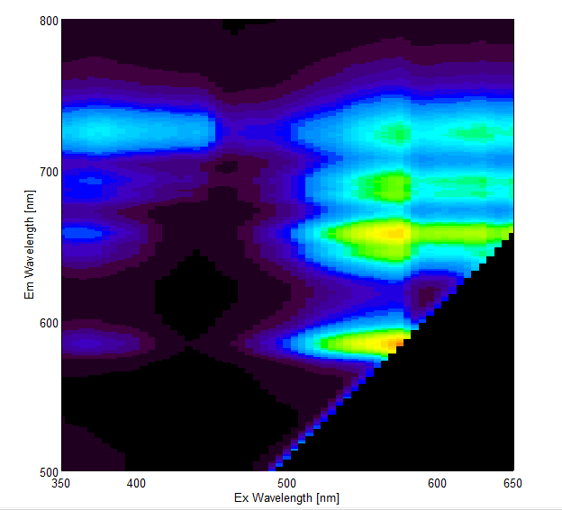
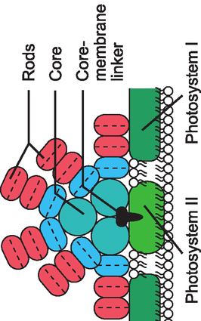
Chl a
PBS
PE
PC
PBS-PSI
Chl-PSI
PE-PSI
PC-PSI
PBS-PSII
Chl-PSII
PE-PSII
PC-PSII
PC+APC
PC+APC
PC+APC
PE
PE

Slide 8
Example 77K spectra
800
PBS-PSI
Chl-PSI
PE-PSI
PC-PSI
700
PBS-PSII
Chl-PSII
PE-PSII
PC-PSII
PBS
PE
PC+APC
Emission wavelength (nm)
600
PBS
PE
500
400
600
650
500
Excitation wavelength (nm)

Slide 9
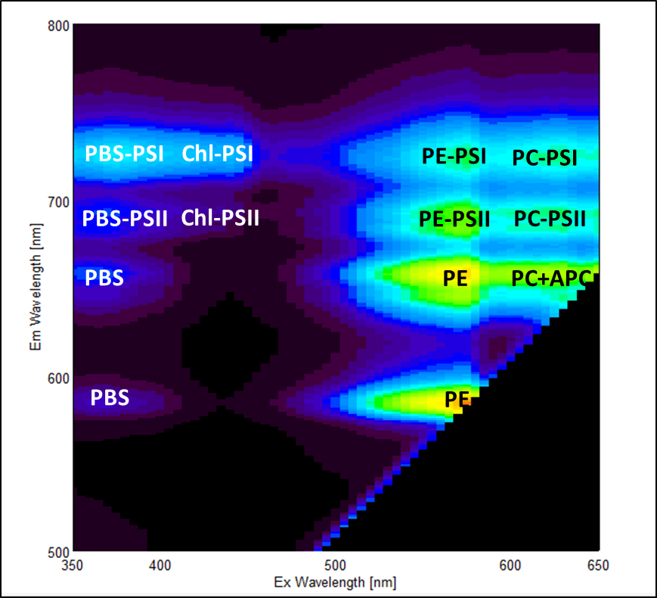
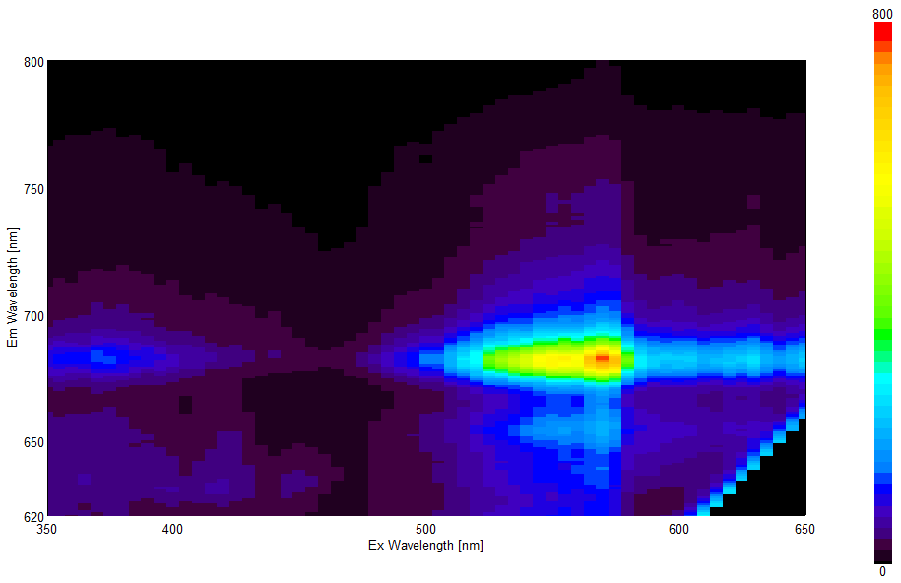
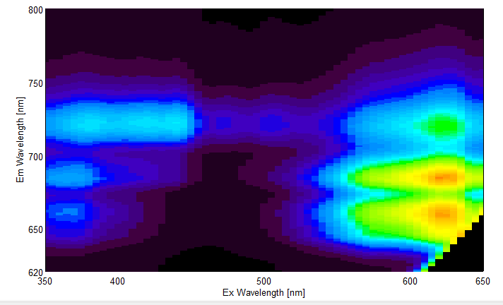
Nostoc
PE-strain
Syn 6803

Slide 10
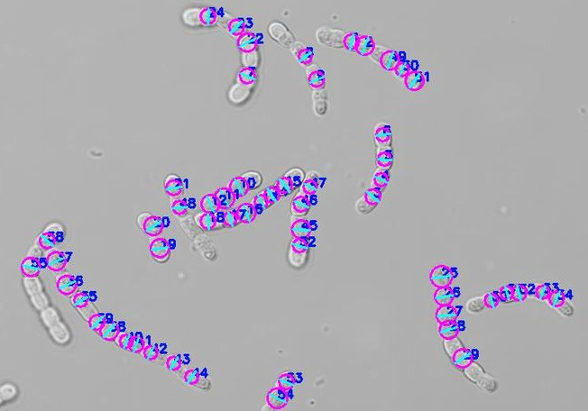

Slide 11
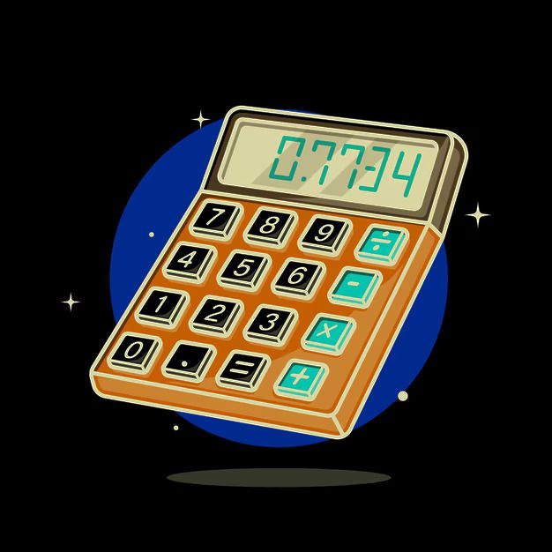

42

Slide 12
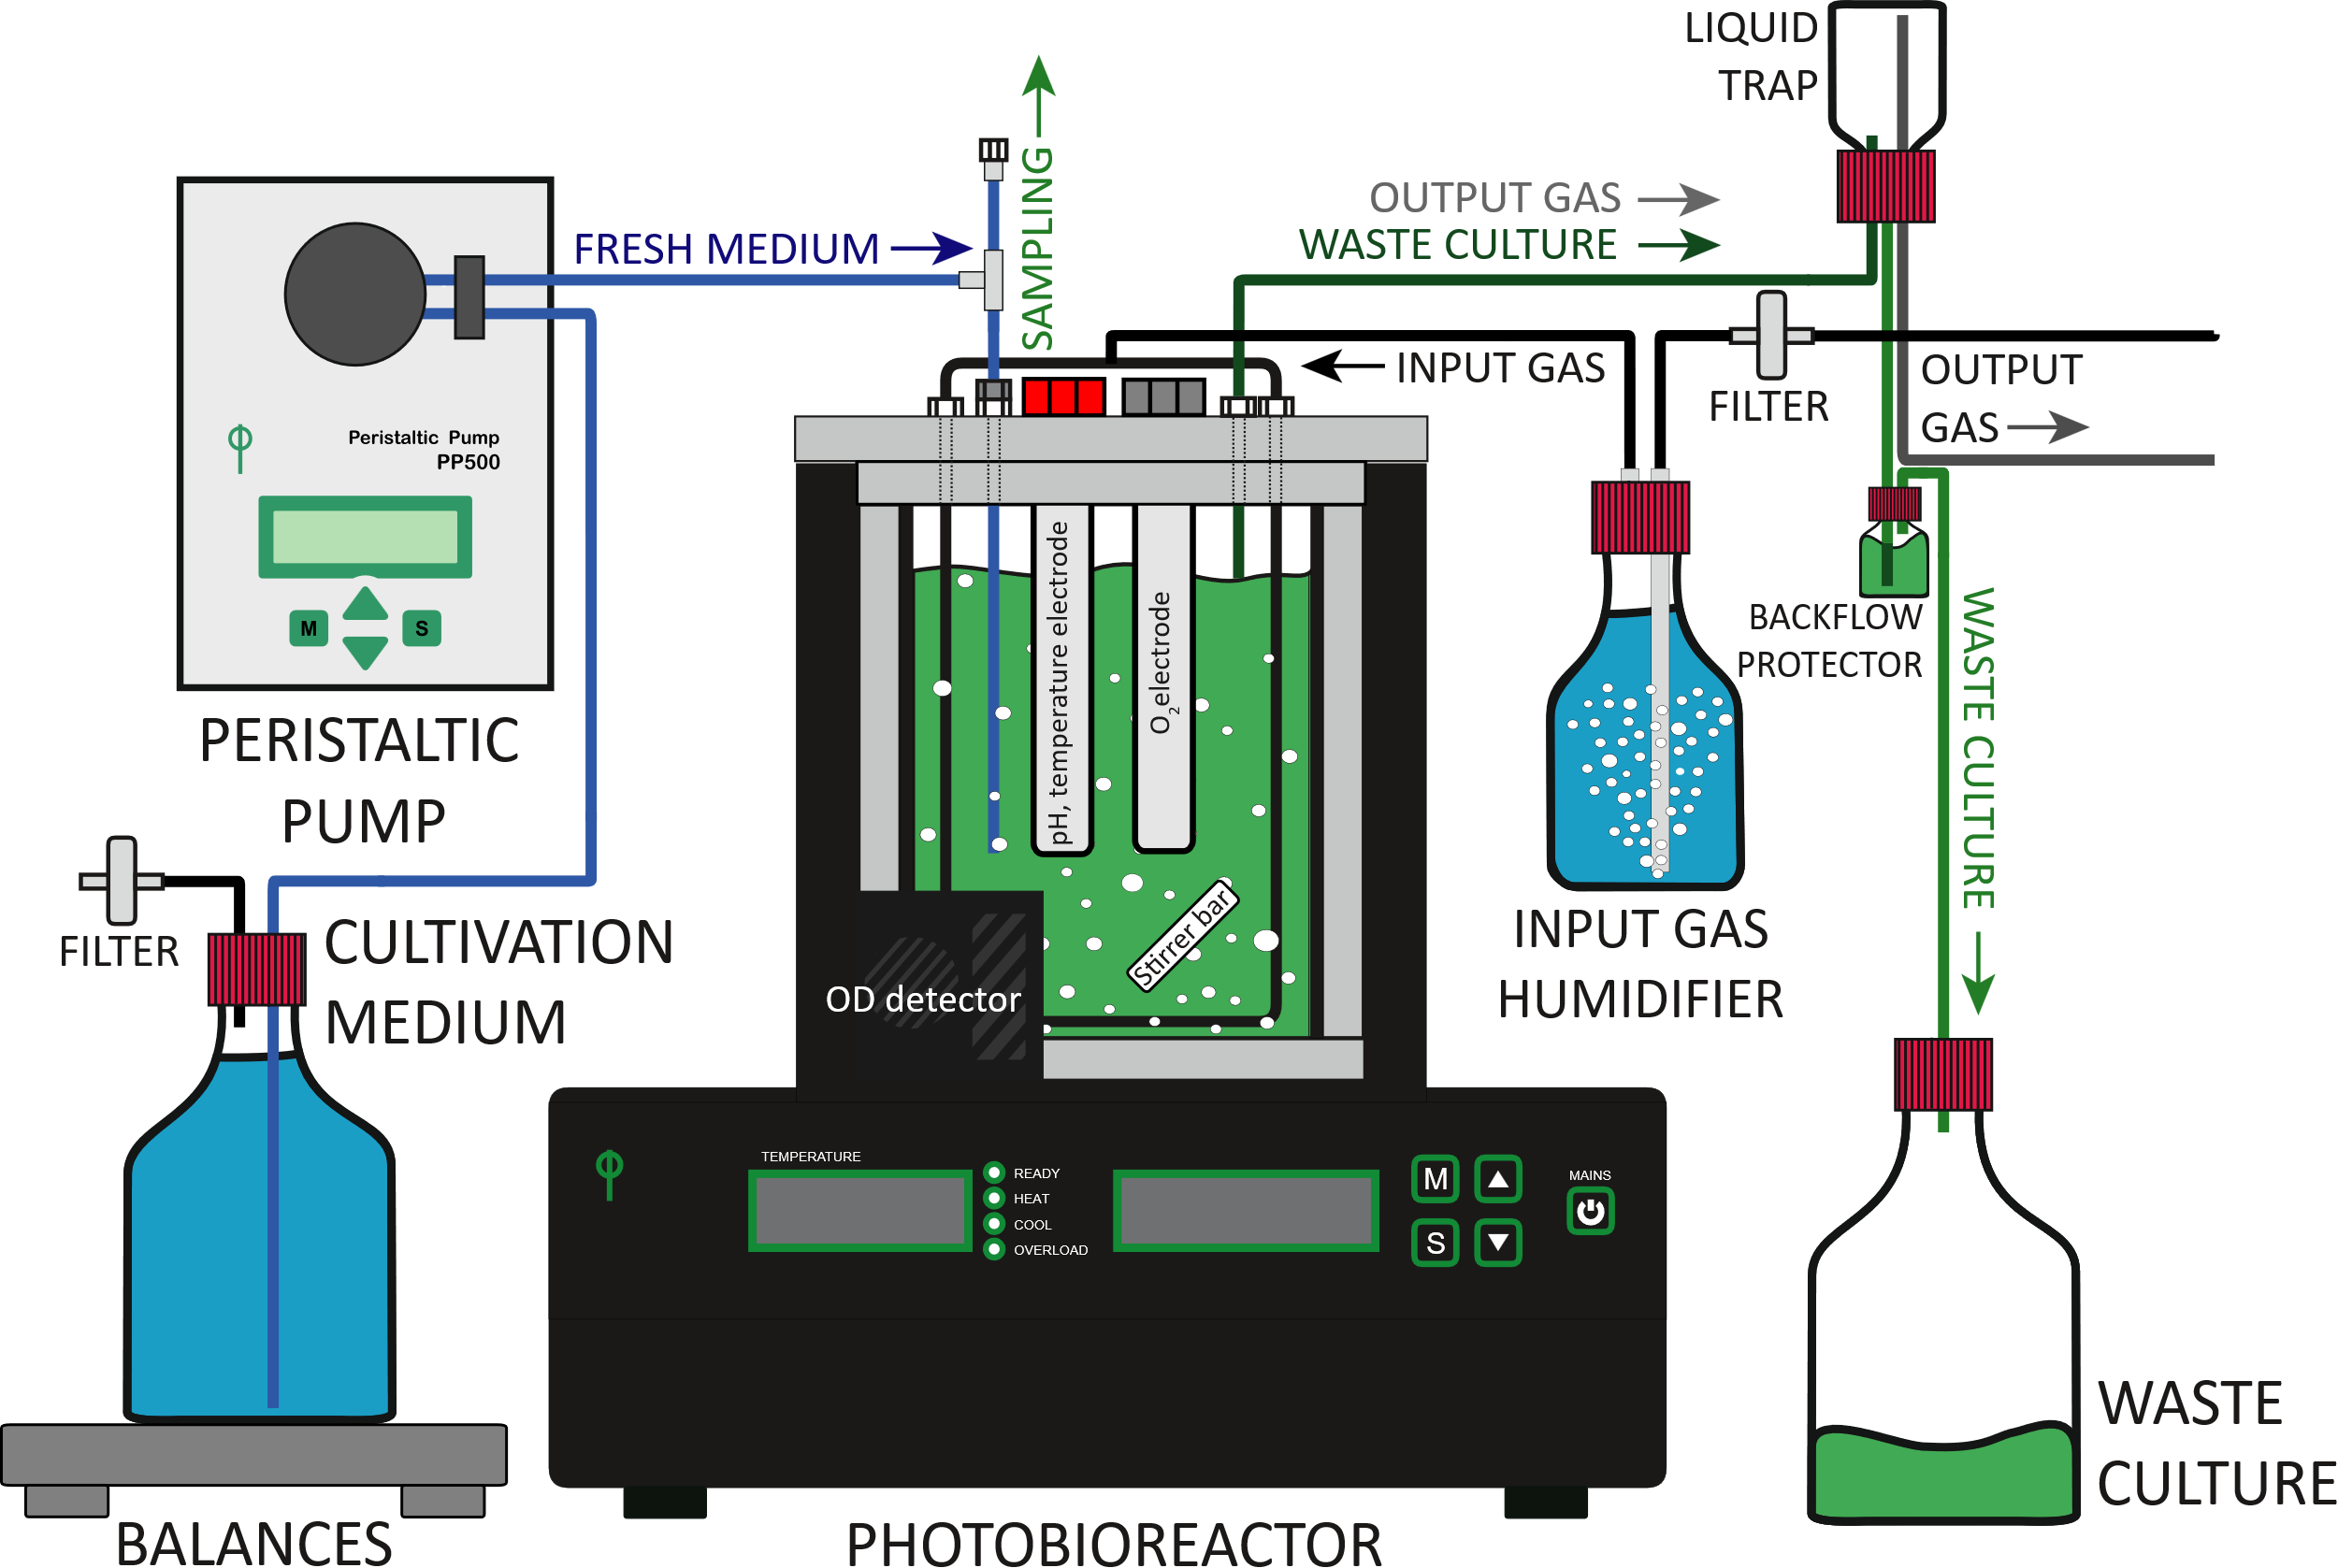

Slide 13
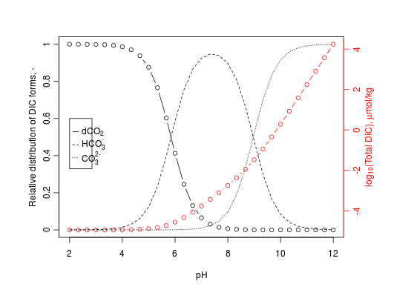

Slide 14
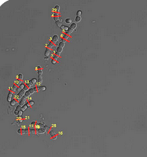
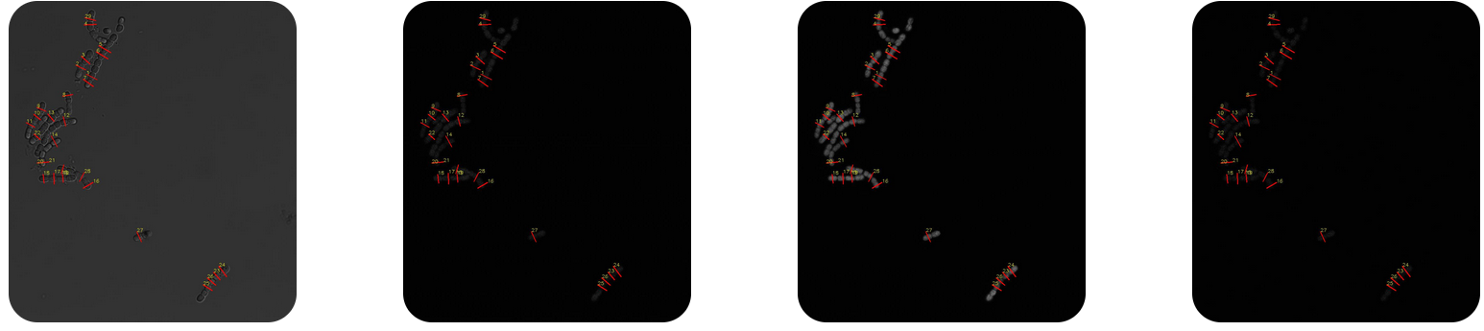
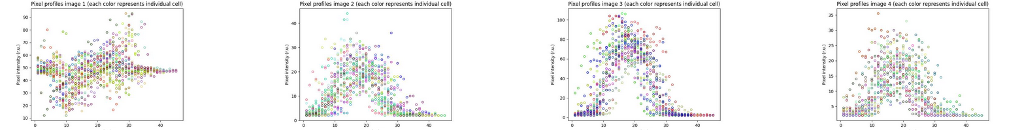
Workflow for pixel intensity analysis from confocal microscopy images in cyanobacteria cells (Nostoc sp.)
Cells selection
Selected cells:
Bright field
Selected cells:
Fluorescence channel 1
Selected cells:
Fluorescence channel 2
Selected cells:
Fluorescence channel 3
Pixel intensities: bright field
Pixel intensities: channel 1
Pixel intensities: channel 2
Pixel intensities: channel 3

Slide 15
Cells selection
Selected cells:
Bright field
Selected cells:
Fluorescence channel 1
Selected cells:
Fluorescence channel 2
Selected cells:
Fluorescence channel 3
Pixel intensities: bright field
Pixel intensities: channel 1
Pixel intensities: channel 2
Pixel intensities: channel 3

Slide 16
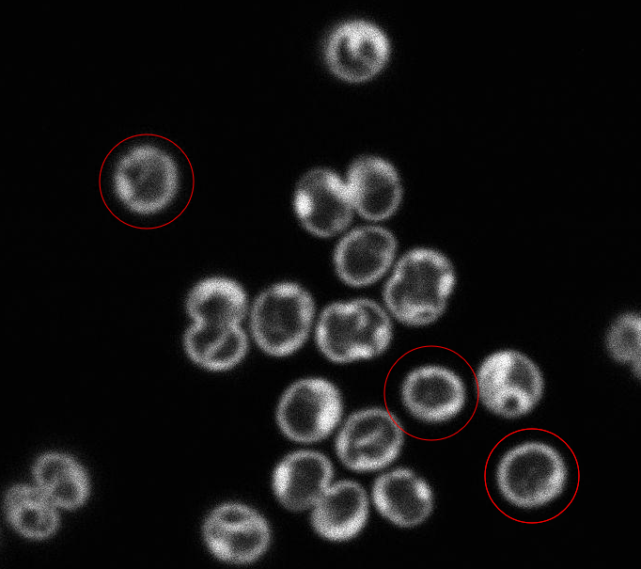
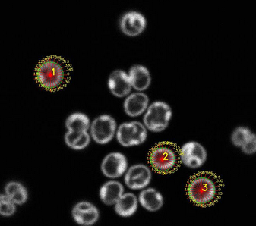
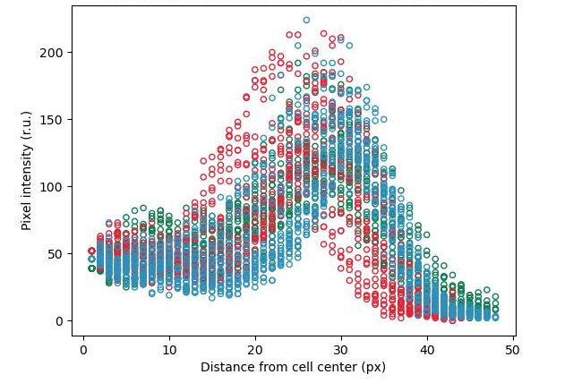
Workflow for pixel intensity analysis from confocal microscopy images in cyanobacteria cells (Synechocystis sp.)
Selected cells:
Fluorescence
Selected cells: pixels intensity profiles
(each color represents individual cell)
Cells selection
Selected cells:
Fluorescence
Selected cells: pixels intensity profiles
(each color represents individual cell)
Cells selection

Slide 17
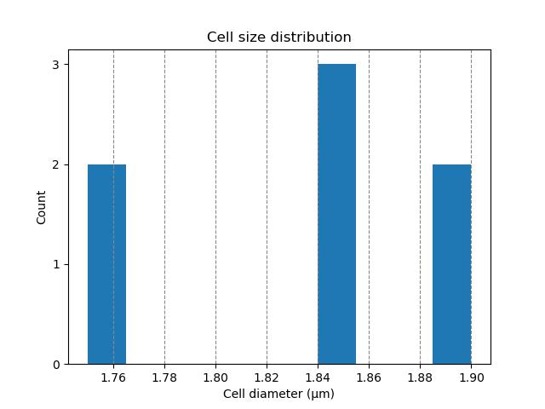
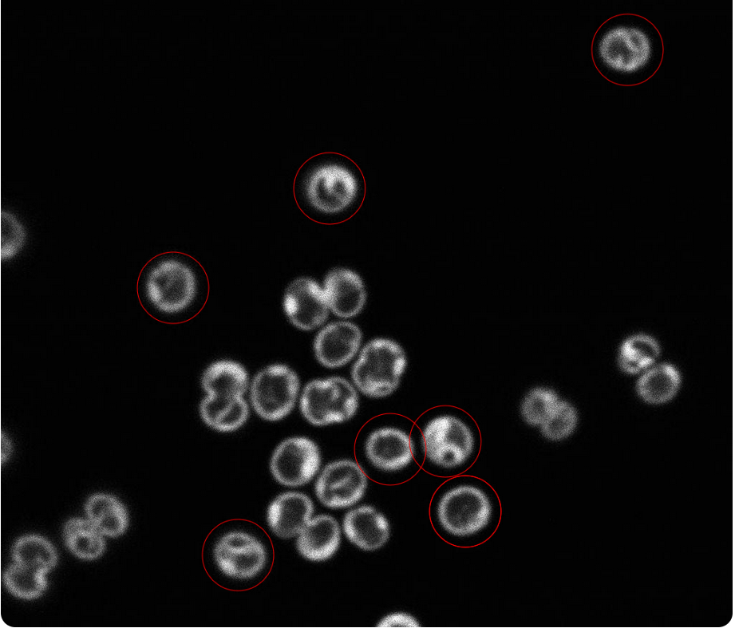
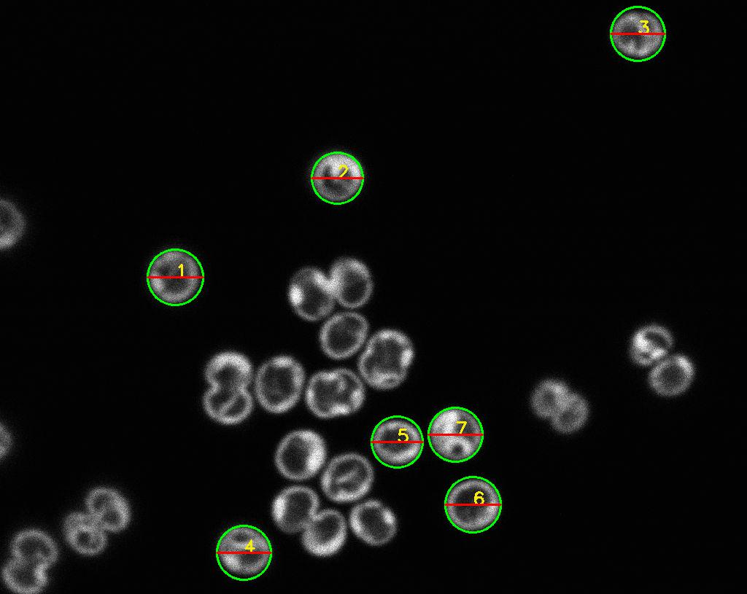
Workflow for cell size analysis from confocal microscopy images in cyanobacteria (Synechocystis sp.)
Selected cells:
Diameters
Selected cells:
Cell diameter histogram
Cells selection
Selected cells:
Diameters
Selected cells:
Cell diameter histogram
Cells selection

Slide 18
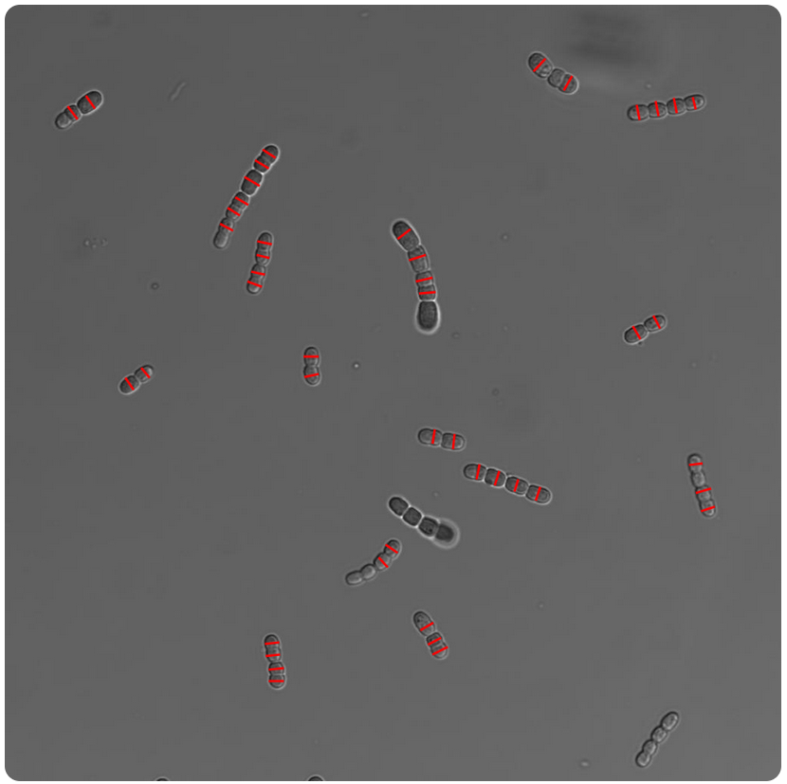
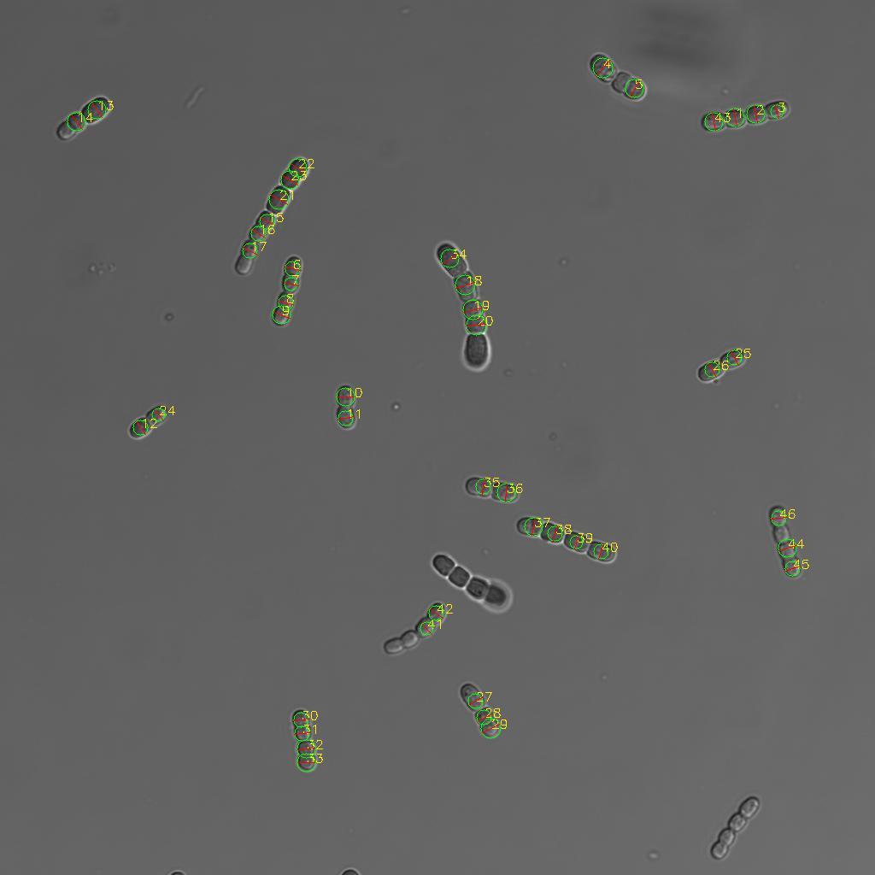
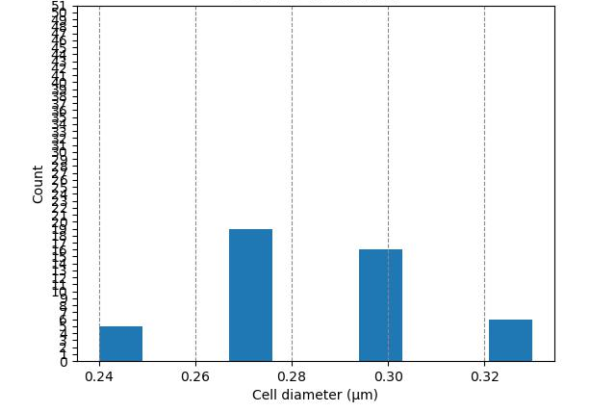
Workflow for cell size analysis from confocal microscopy images in cyanobacteria (Nostoc sp.)
Cells selection
Selected cells:
Diameters
Selected cells:
Cell diameter histogram
50
40
30
Count
20
10
0
Cells selection
Selected cells:
Diameters
Selected cells:
Cell diameter histogram
50
40
30
Count
20
10
0

Slide 19
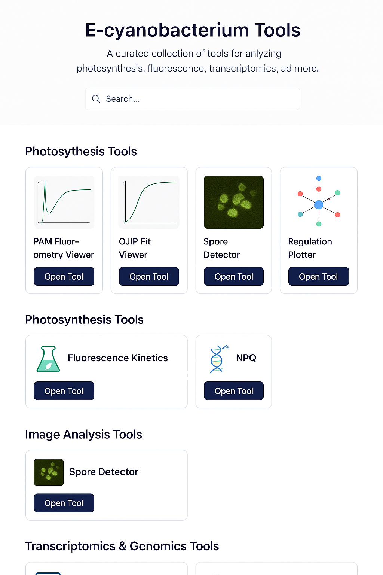
Welcome to CyanoTools!
Homepage suggestion
This site offers tools for analyzing data acquaried by methods routinely used in laboratories working with cyanobacteria, algae, plants or bacteria. The site is developed at Department of Adaptive Biotechnologies (DoAB) of Global Change Research Institute of the Czech Academy of Sciences (CzechGlobe). To begin, pease select a tool from the options below.
Updates of the CyanoTools webiste are being added regularly. For the latest updates, check the development log.
Photosynthesis tools
Rapid Light Curves
OJIP Curves
Slow kinetics
Fluorescence spectroscopy tools
🦠
77K Excitation-emission spectra
Cell counting tools
Cell counting - round cells
Cell counting - filaments

Slide 20
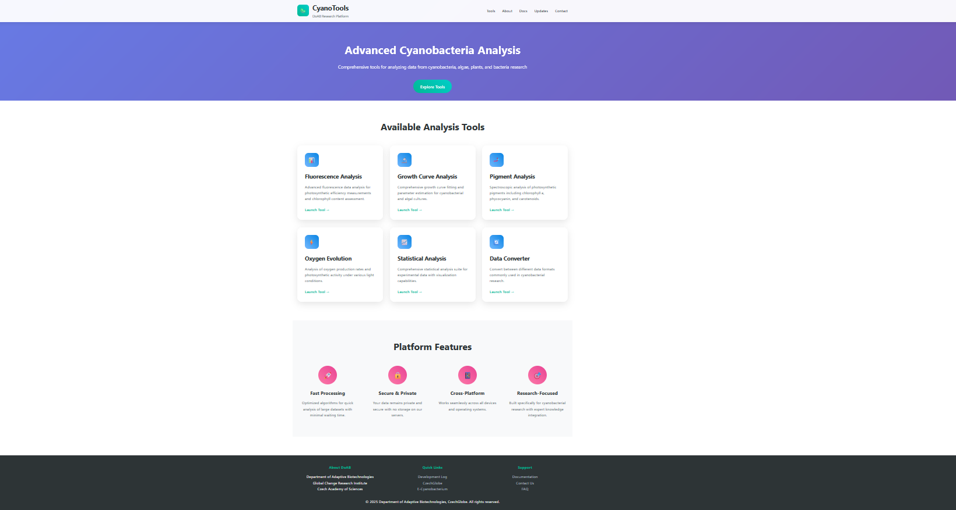

Slide 21




Jeste zadat, aby logo symbolizovalo data analysis a fotosyntezu

Slide 22
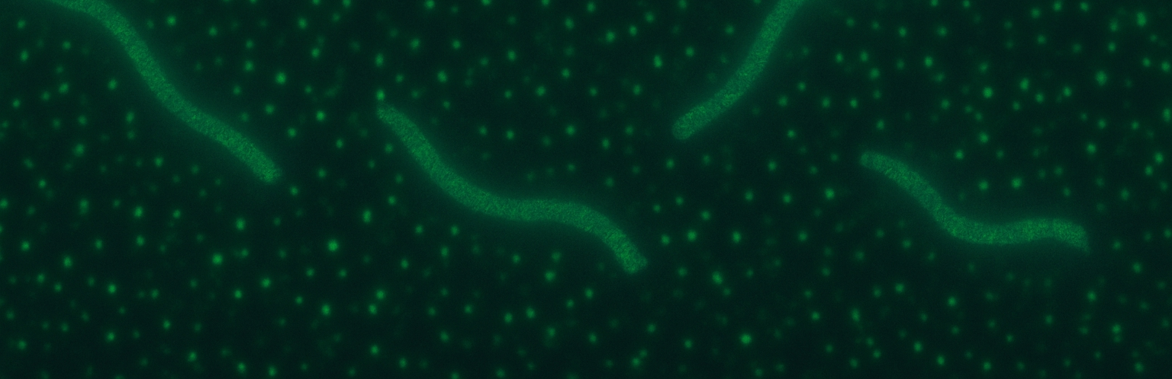


Slide 23


